Slide 1

Object Detection
Object localization
deeplearning.ai

Slide 2
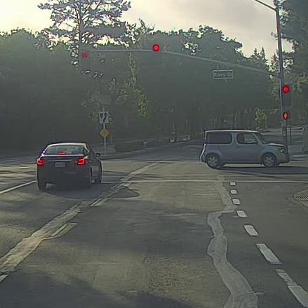
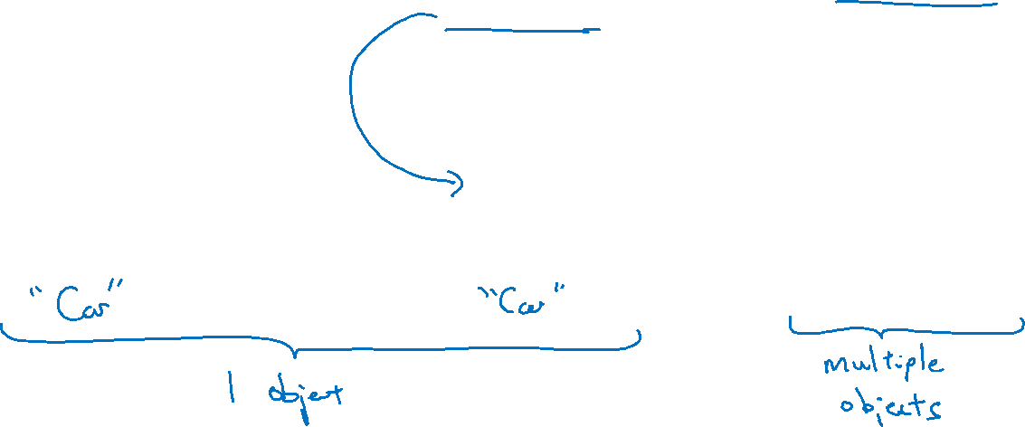
What are localization and detection?
Image classification
Classification with
localization
Detection

Slide 3


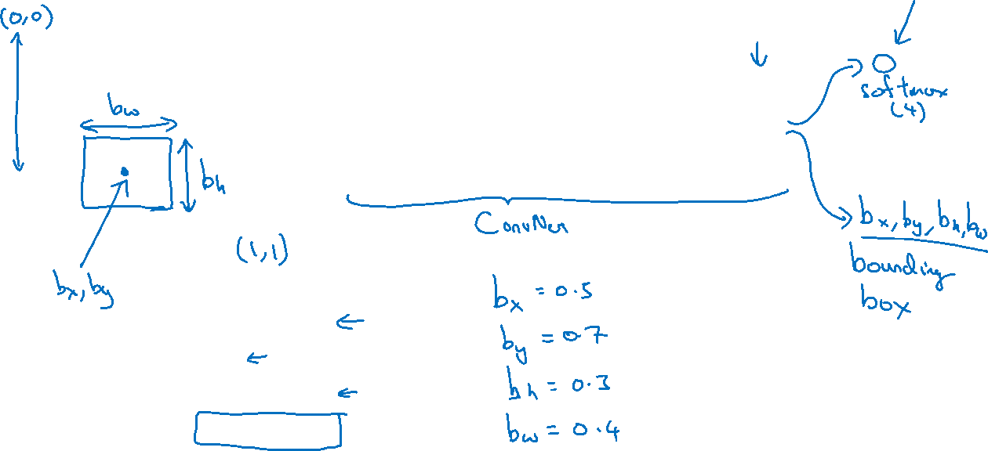
Classification with localization
$$⋯$$
$$⋮$$
1 - pedestrian
2 - car
3 - motorcycle
4 - background

Slide 4
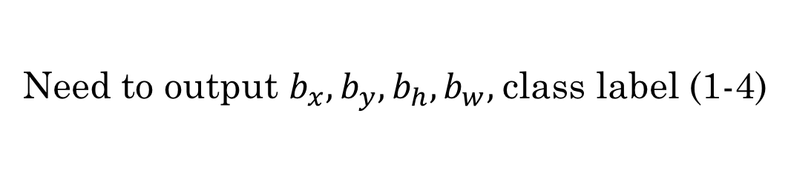
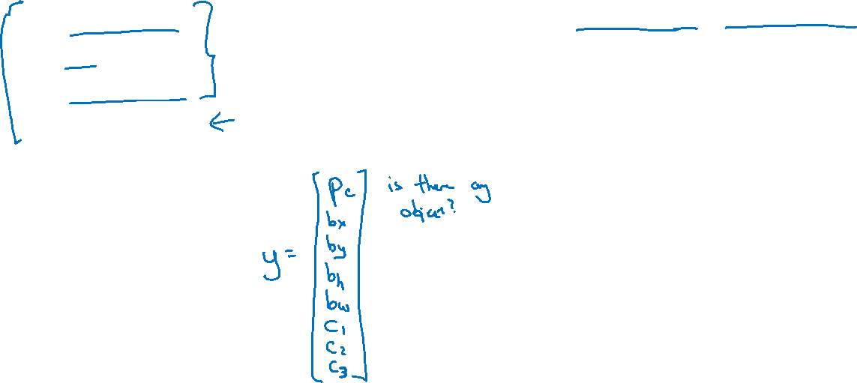
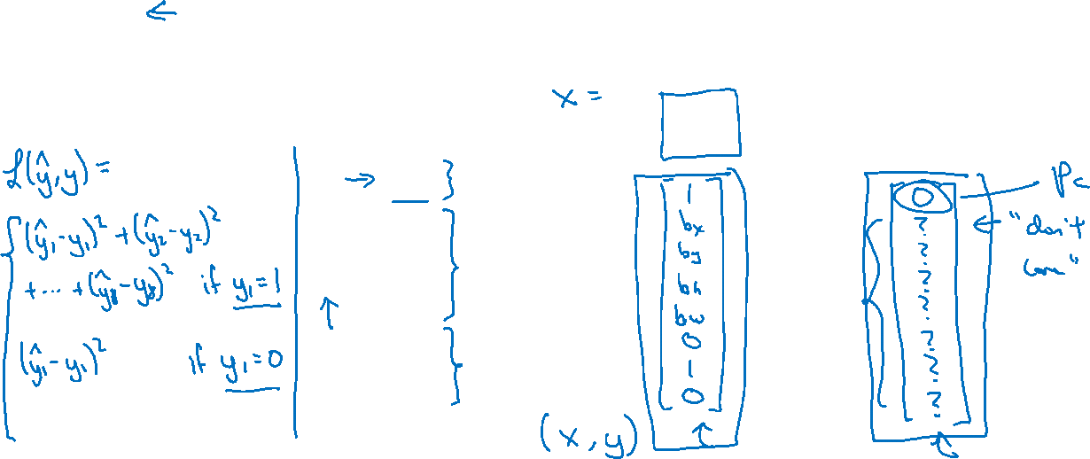
Defining the target label y
1 - pedestrian
Need to output $b_{x},b_{y},b_{h}, b_{w},$class label (1-4)
2 - car
3 - motorcycle
4 - background

